Slide 1
COFFEE SHOP
BILLING SYSTEM

Slide 2

<<OUTLINE>>
Introduction
Main Features
Java Concepts
Menu Card
Conclusion
Questions

Slide 3
Introduction and Objectives
We wll explore a Java console application on how to show the menu card to the customers who come to our shop, how to give orders and how to give the bill.
This is essential to improve customer experience and increase operational efficiency.
Join us in this presentation to discover how technology can be harnessed to create a smoother, more satisfying dining experience for customers and improved efficiency for shop staff.

Slide 4
Main Features
1
Displaying Menu Card
2
Odering items by
the Customer
3
Preparing the bill and
Getting Customer details
4
Displaying the bill in the system

Slide 5
System Flow
01
02
03
04
05
Display the Menu card
Get Item Order
Prepare the bill with customer details
Exit from the program.
Display the Bill

Slide 6
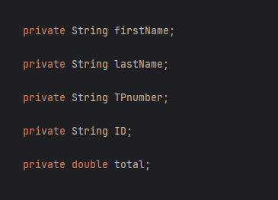

Java Concepts
Access Modifiers

Slide 7
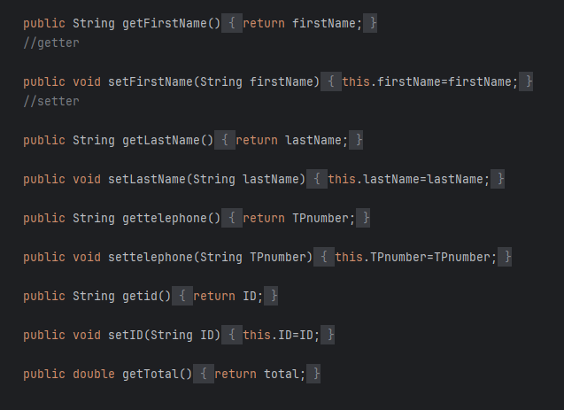
Java Concepts
Encapsulation

Slide 8
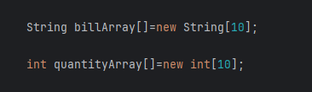
Java Concepts
Array

Slide 9
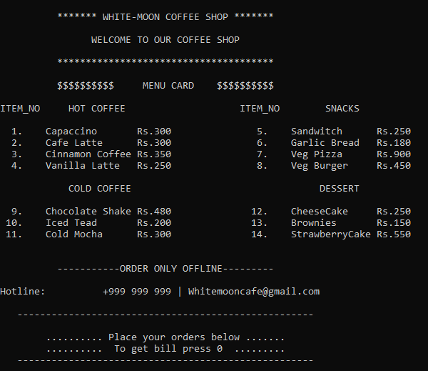
<<Menu Card>>

Slide 10

Conclusion
We present the system, order management algorithm, Bill processing, key features and benefits of our billing system are covered.
This technology improves customer service by optimizing order intake and improving shop efficiency.
As we conclude, consider the tremendous potential this system has for improving the dining experience and the opportunities it presents for future advancements in the restaurant industry.

Slide 11

Questions ?

Slide 12

GROUP MEMBERS
2020/ICTS/037
2020/ICTS/042
2020/ICTS/112
2020/ICTS/140
2020/ICTS/141
MADHUBHASHINIE B.S
THARAKA W.M.M
BANDARA M.H.G.N.P
KARUNATHILAKA K.D.I
RATHNAYAKA I.P

Slide 13
Thank You!

